Slide 1

Retail Sales Analysis: Driving Data-Informed Decisions
This presentation outlines a retail sales analysis project using MySQL. Our primary goal is to extract valuable business insights from sales data, empowering stakeholders to make more informed decisions. We will cover the project overview, database schema, data cleaning processes, and key analytical queries used to achieve this objective.

Slide 2




Project Overview and Objectives
Analyze Retail Sales Data
Utilizing MySQL to process and interpret comprehensive retail sales information.
Extract Business Insights
Identifying valuable patterns and trends within the sales data to inform strategy.
Aid Stakeholder Decisions
Providing data-driven recommendations to support stakeholders in their strategic planning.
The project's core is to transform raw sales data into actionable intelligence. By leveraging MySQL, we aim to uncover hidden opportunities and challenges, ultimately guiding better business outcomes for all involved stakeholders.

Slide 3

Database Schema: Retail Sales Table
transaction_id
INT
Primary Key
sale_date
DATE
Date of sale
sale_time
TIME
Time of sale
customer_id
INT
Unique customer identifier
gender
VARCHAR
Customer gender
age
INT
Customer age
category
VARCHAR
Product category
quantity
INT
Quantity sold
price_per_unit
FLOAT
Price per unit
cogs
FLOAT
Cost of goods sold
total_sale
FLOAT
Total sale amount
The project utilizes a single table, 'retail_sales', structured to capture all essential transaction details. This comprehensive schema allows for detailed analysis across various dimensions, from customer demographics to product performance.

Slide 4




Data Cleaning Process
Remove Missing Values
Eliminated records with NULL or missing data in critical fields to ensure data integrity.
Standardize Data
Applied consistent formats across all data points for accurate and reliable analysis.
Ensure Trustworthiness
Validated the cleaned data to provide a solid foundation for all subsequent analysis.
Data cleaning is a crucial step to ensure the accuracy and reliability of our analysis. By meticulously removing incomplete records and standardizing formats, we establish a robust dataset that yields trustworthy insights for decision-making.

Slide 5
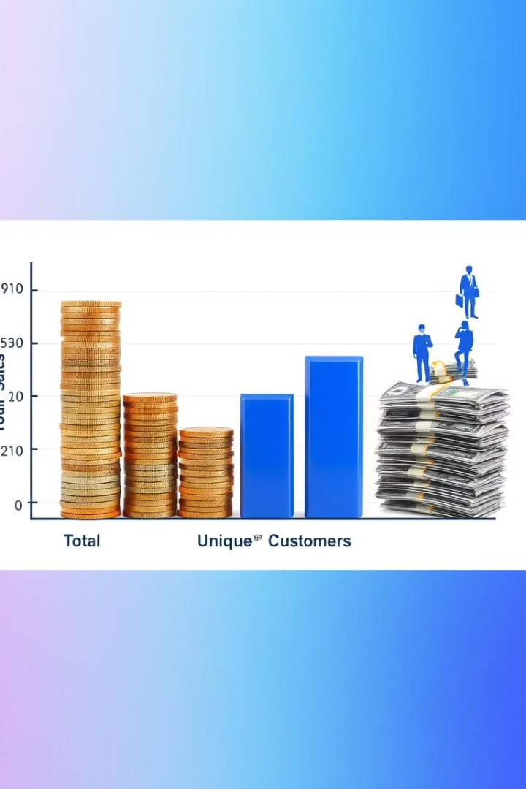
Key Analytical Queries: Sales Overview
Total Sales
Unique Customers
Total Sales Transactions
Unique Customer Count
Count of all sales records in the database.
Number of distinct customers who made purchases.
Our initial analysis focuses on fundamental sales metrics. We determine the total number of sales transactions and identify the count of unique customers, providing a high-level overview of sales activity and customer engagement.

Slide 6
Targeted Transaction Analysis
Specific Criteria
Query Objective
Transactions where the product category is 'Clothing'.
Retrieve all transactions matching these precise conditions.
Quantity purchased is greater than 4 units.
This helps in identifying specific sales patterns and customer behavior for targeted campaigns or inventory management.
Transaction date falls within November 2022.
We delve into specific transaction details to uncover granular insights. By filtering for clothing sales with quantities over four units in November 2022, we can pinpoint particular purchasing behaviors and seasonal trends, aiding in more focused business strategies.

Slide 7
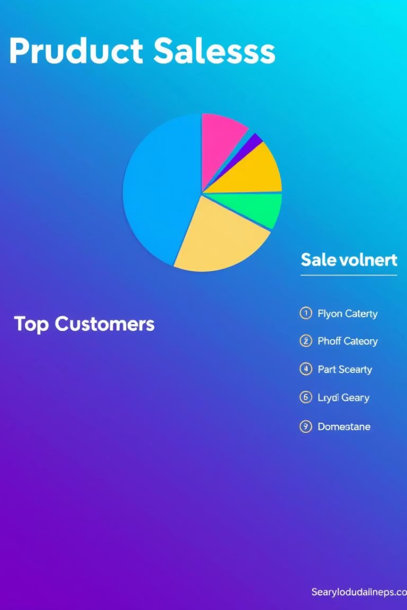
Sales Performance by Category and Customer
Total Sales by Category
Calculated the aggregate sales revenue for each distinct product category.
This helps in understanding which product lines are performing best.
Top 5 Customers by Sales
Identified the five customers with the highest total sales contributions.
This highlights key customers for loyalty programs or personalized marketing.
Understanding sales performance involves analyzing both product categories and individual customer contributions. By calculating total sales per category, we gain insights into product popularity, while identifying top customers helps in recognizing and rewarding high-value clients.

Slide 8

Order Analysis by Shift
1
Morning Shift
Count of orders placed during morning hours.
2
Afternoon Shift
Count of orders placed during afternoon hours.
3
Evening Shift
Count of orders placed during evening hours.
Analyzing the number of orders by shift provides valuable insights into peak business hours. This data can inform staffing decisions, marketing campaign timing, and operational adjustments to optimize efficiency and customer service throughout the day.

